Slide 1


Slide 2
Ground Freight Services include: Truckload Services – Domestic border
The distribution of goods is an important link in the supply chain. Experience and reliability are necessary conditions for all products to be delivered safely and consistently to their final recipients.
EAGLE COURIER processes all the data related to the deliveries it undertakes, organizing specialized programs, so that every time it ensures the satisfaction of its customers in the shortest time and at the lowest possible cost.

Slide 3
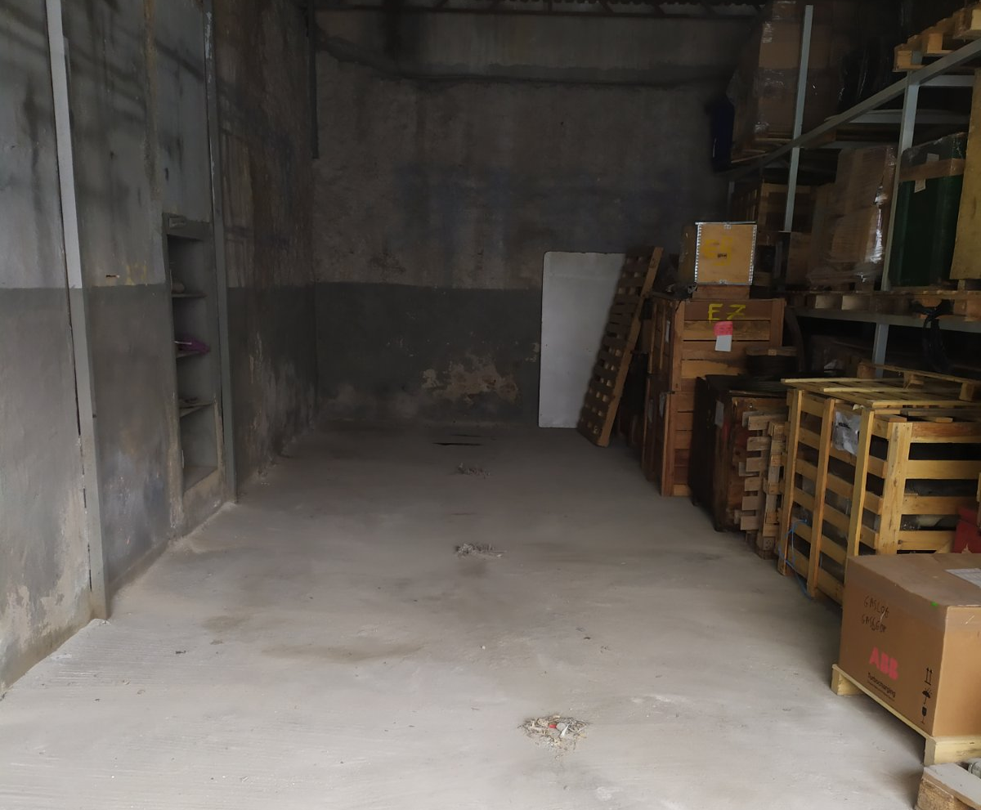
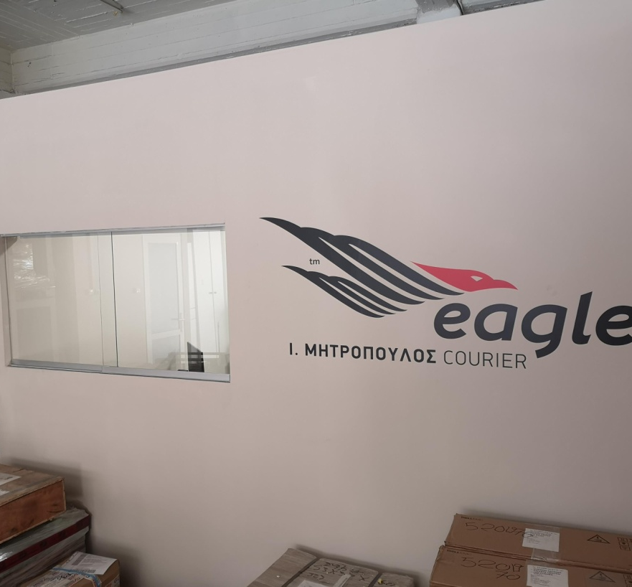
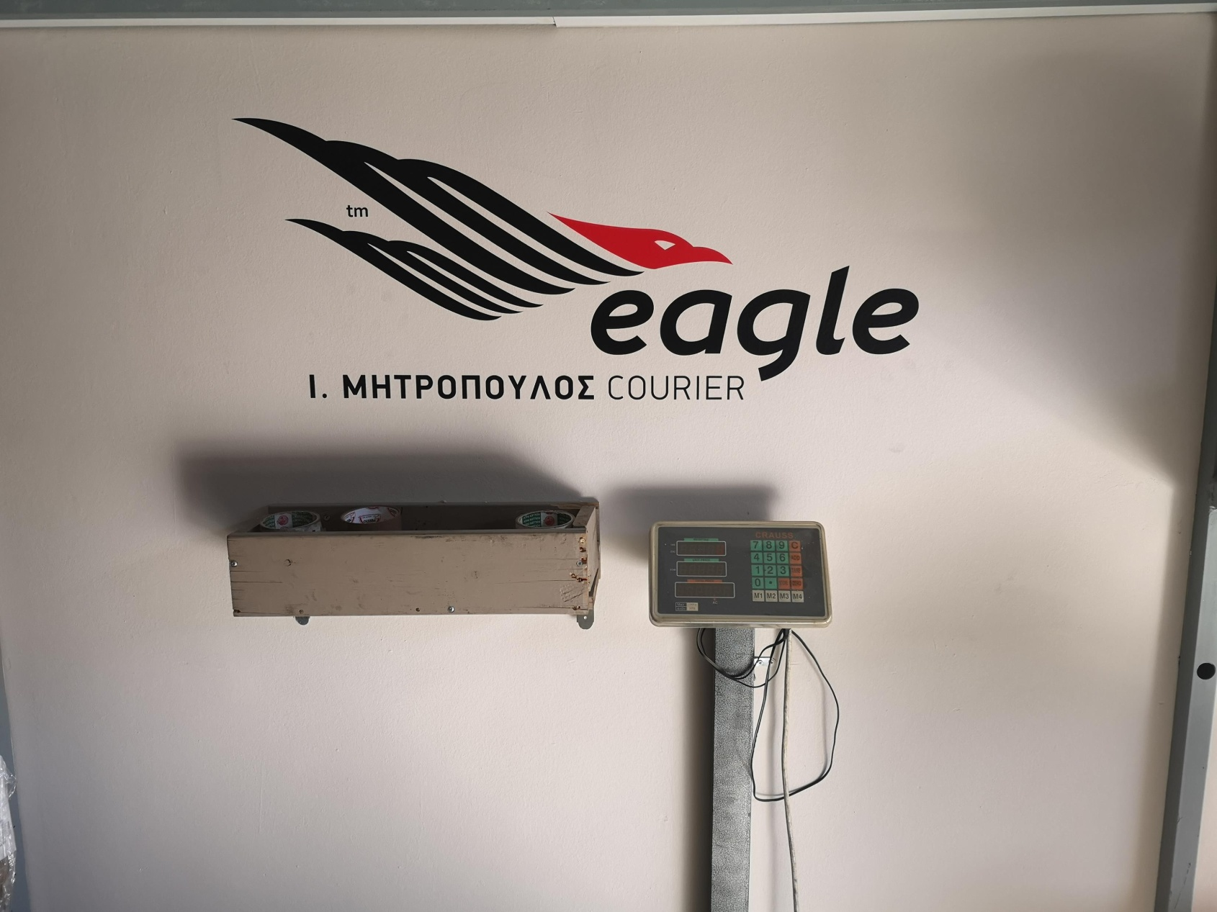
Our warehouse

Slide 4
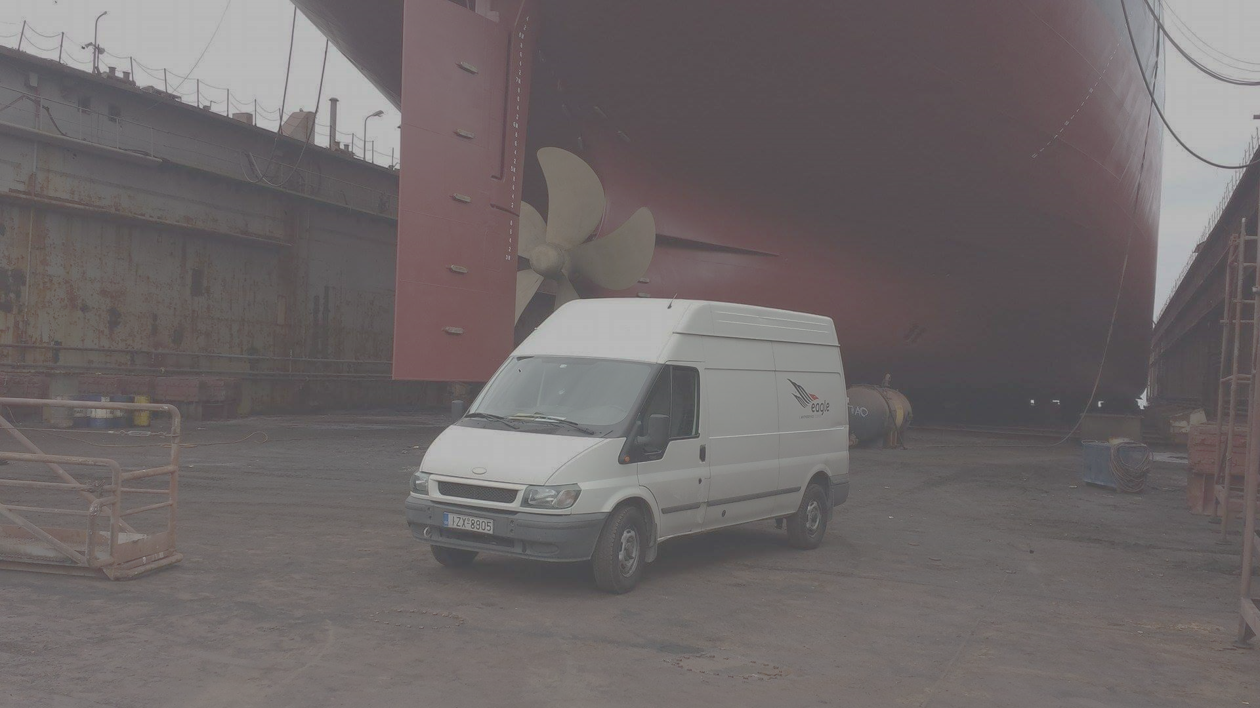
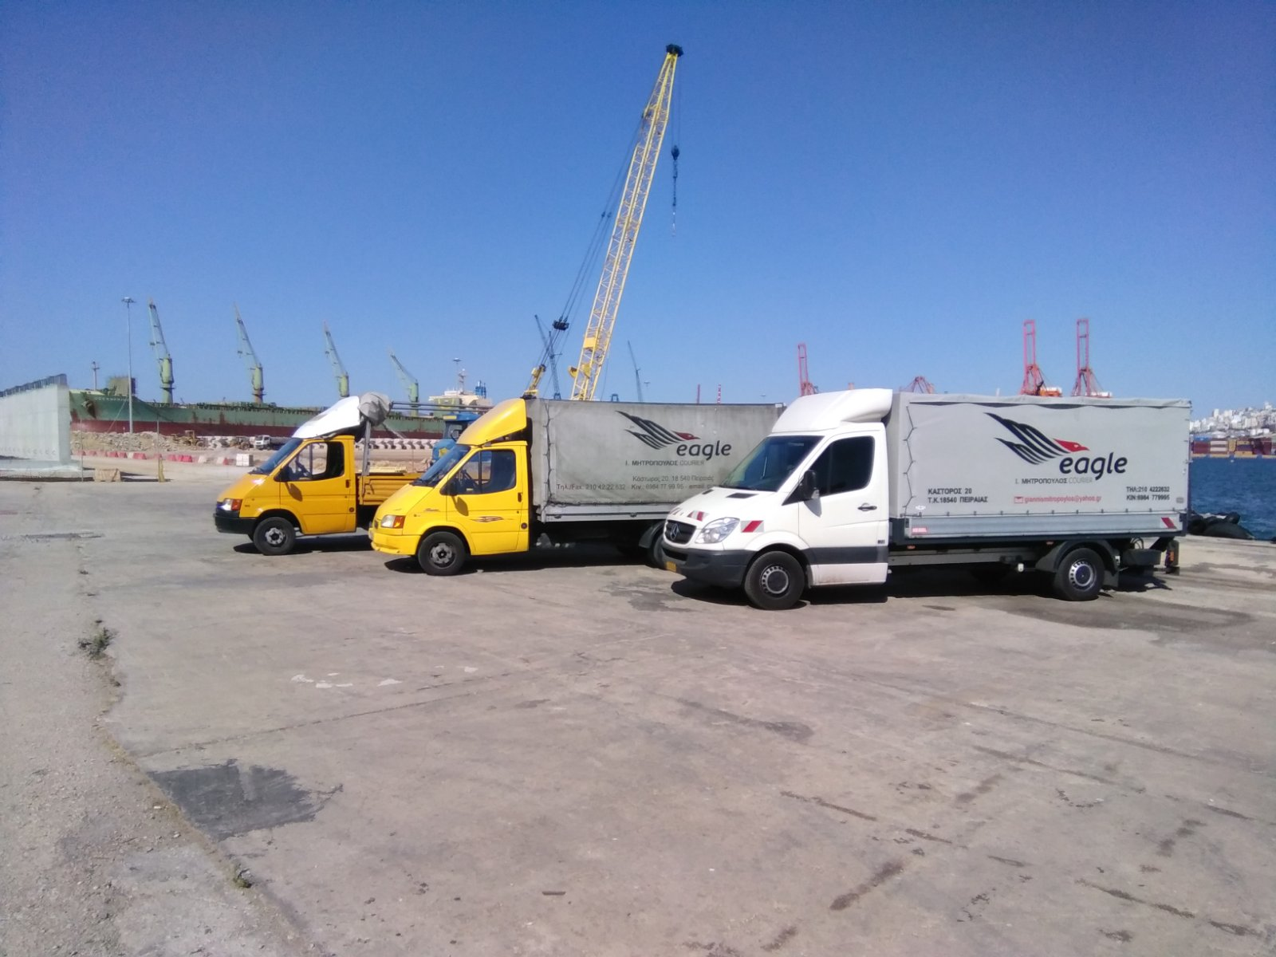
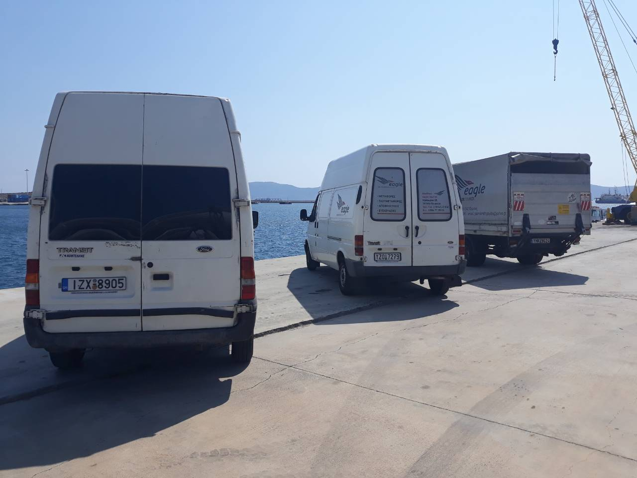
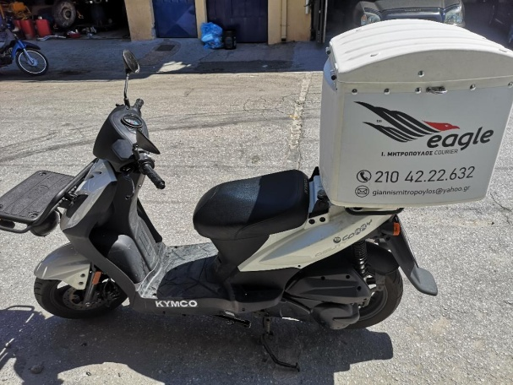
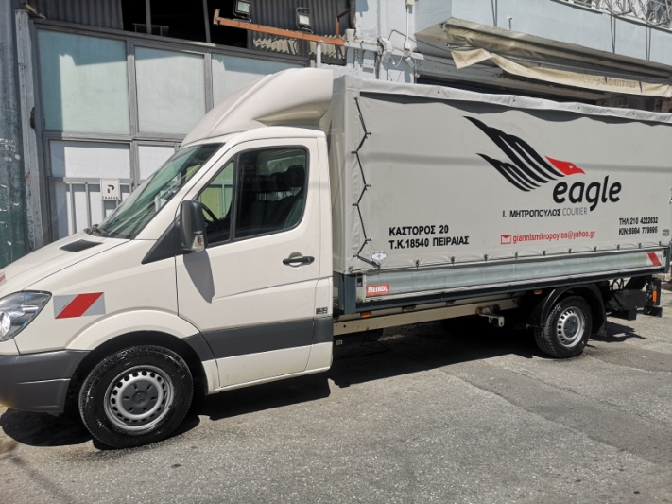
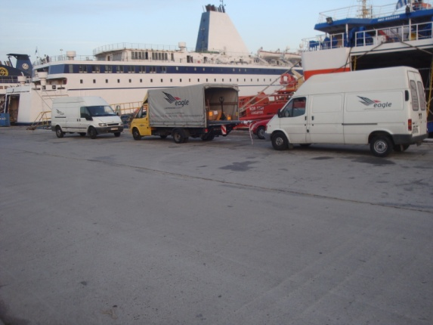
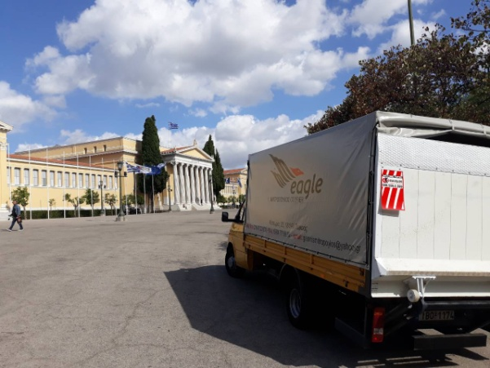

Slide 5
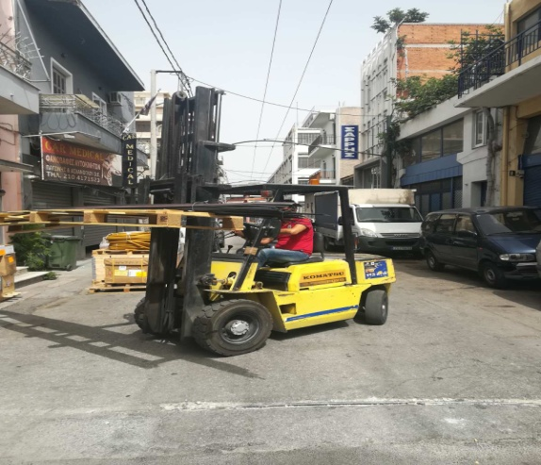
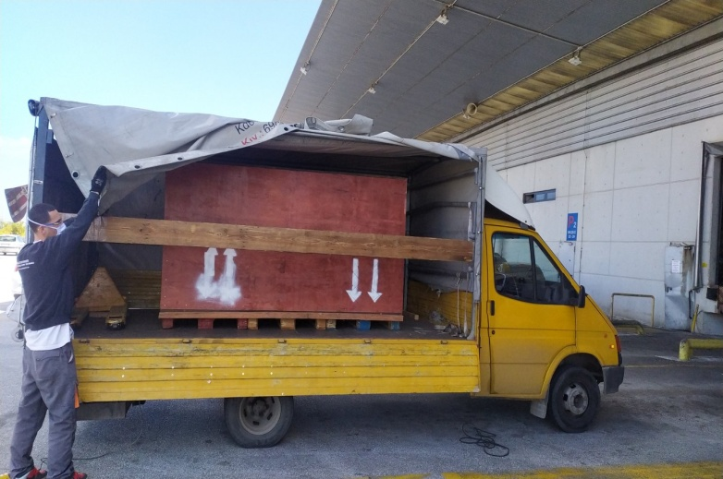
Cross-Docking
Through an organized transport network and based on specific schedules, we undertake the delivery of our customers' goods in Piraeus & Thessaloniki and its surroundings as well as throughout the rest of Greece.
We have a wide fleet of vehicles (towed, flatbed, three-axle and small trucks) that carry out daily loadings with the possibility of same-day (cross-docking) deliveries.
The application of the cross-docking system significantly simplifies the supply chain since it reduces storage times with the main goal of Shipping, which is the products to be delivered on the same day of their receipt.

Slide 6
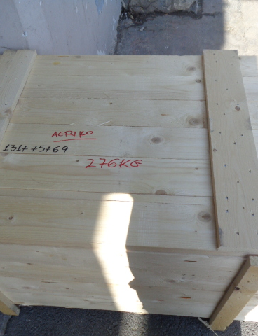
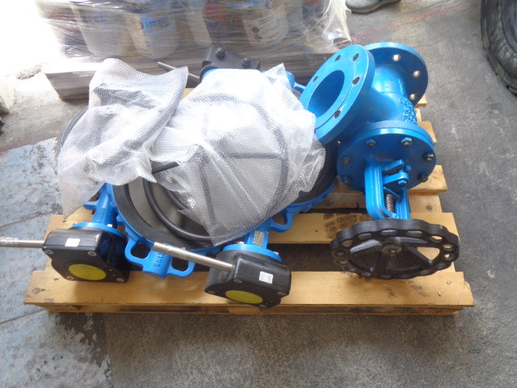
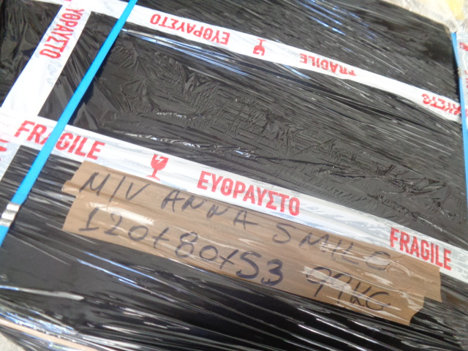
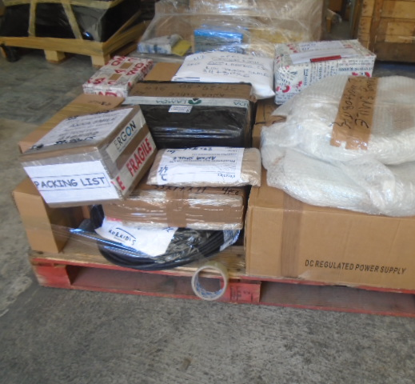
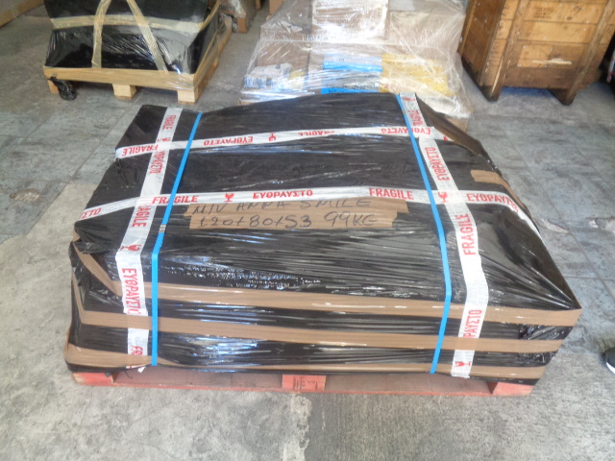
Collection & packaging

Slide 7
Delivery on Board
With excellent knowledge of this forwarding complex and time-sensitive service, we can deliver your valuable orders to your ship by providing the most cost-effective solutions from the collection point or consolidation point and on-board delivery. For parcels unloaded at the port of Piraeus from another vessel, as well.
Control of ship movement
Collection & storage of domestic goods
Handling inbound cargo with a transit permit
Ship movement and cargo status report
Transport and delivery work by sea
Arrangement of special equipment on request

Slide 8
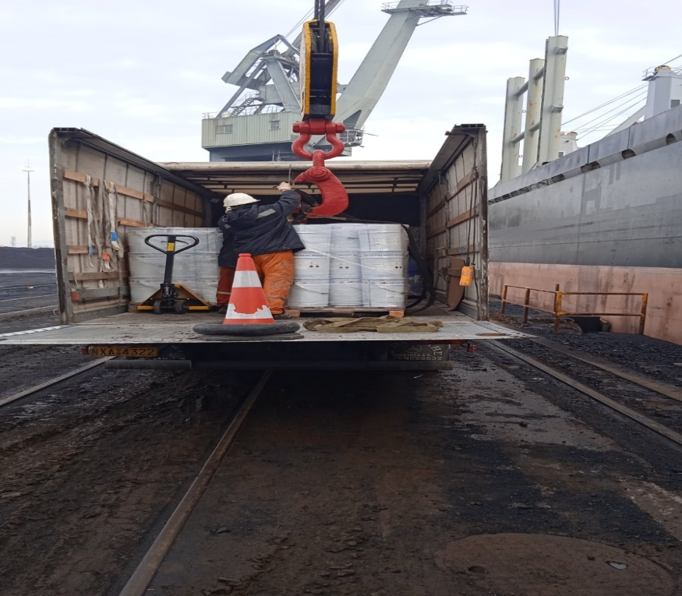
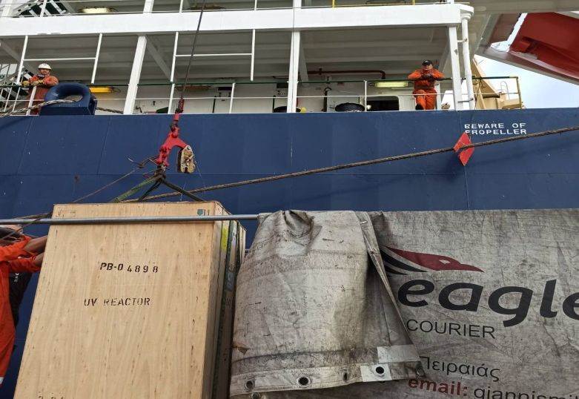
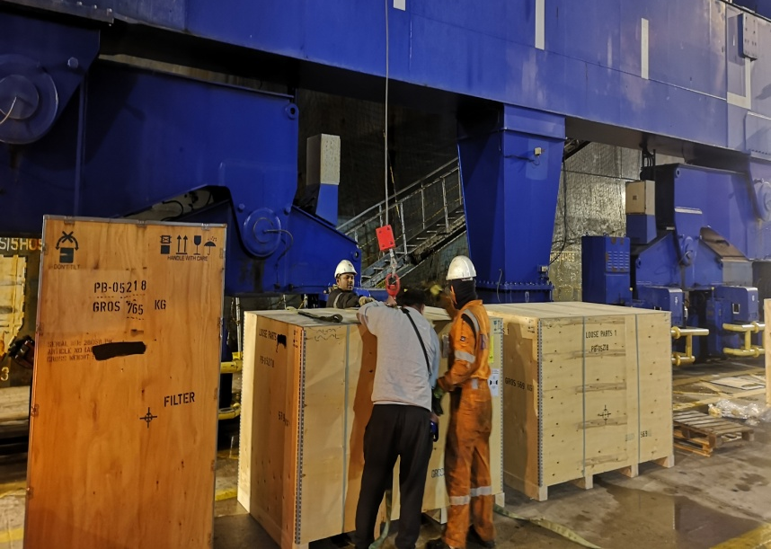
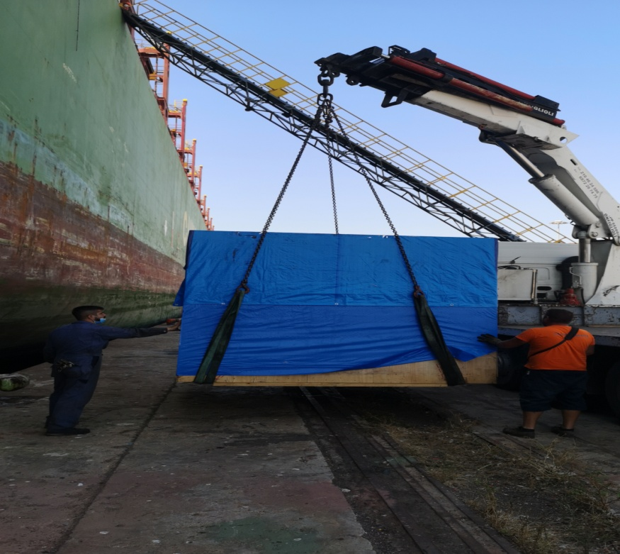
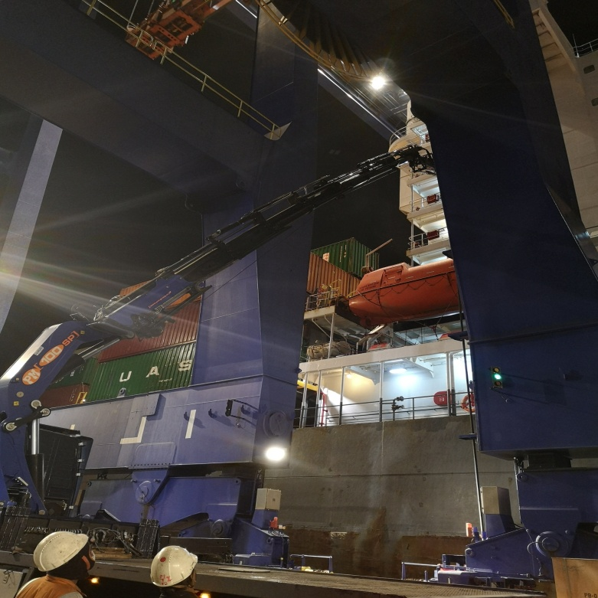
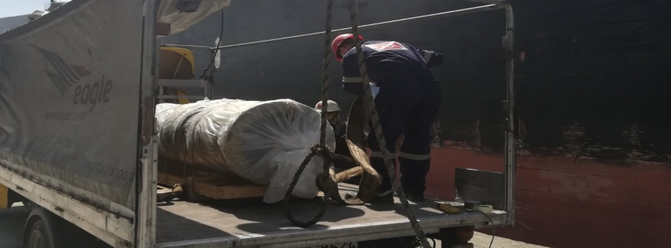

Slide 9

MITROPOYLOS TH. IOANNIS
EAGLE COURIER
Certificate No.: GR003251 Issue date: 17-10-2022
Certification / Recertification cycle start date: 17-10-2022
Expiry date of previous cycle: NA
16-10-2025
17-10-2022
20, Kastoros str., GR 18540 Pireaus, Greece
Freight road transportation. Freight cross-docking and repackaging. Courier services.

Slide 10
Contact Details
Pic: Mitropoylos Ioannis
Tel./Fax.: 210 42.22.632
E-mail: giannismitropoylos@yahoo.gr
Mob: +30 6984.77.99.95

